Slide 1
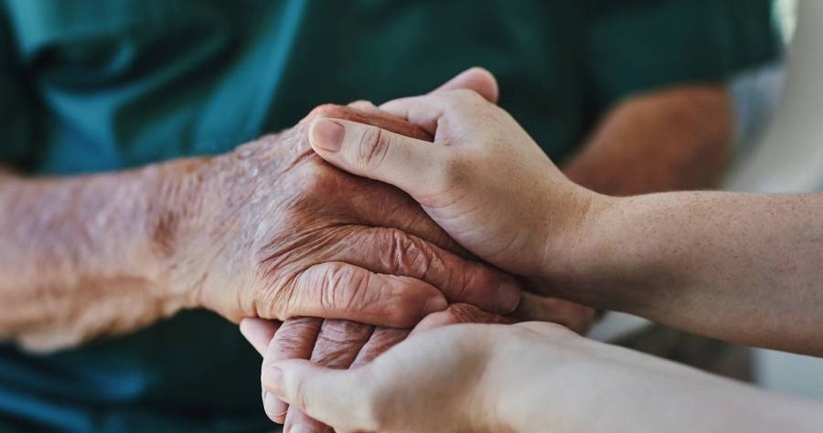
q&a with specific topics
- Chatbot -

Slide 2
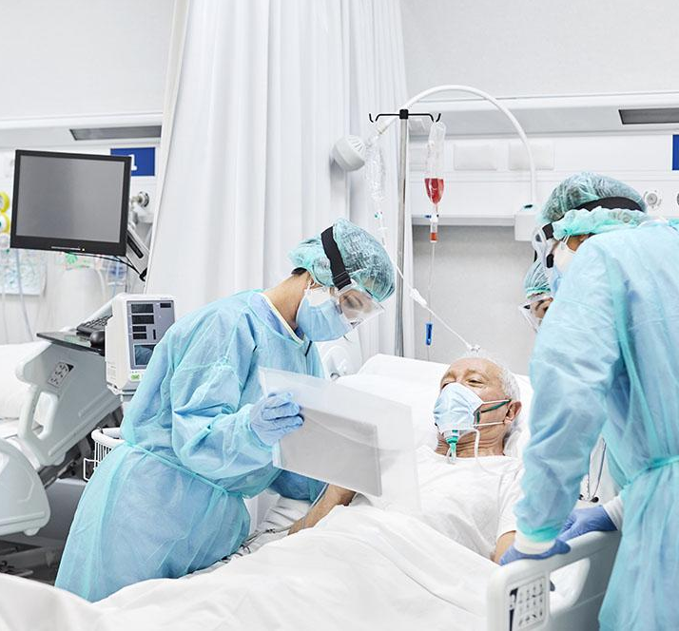
Introduction
m
Difficulty in seeing a doctor, long queuing time, and inconvenience of making appointments have long been hurdles facing patients when they try to access primary care services.
Adding also that the whole world is suffering until now from the global health cries Covid-19.

Slide 3
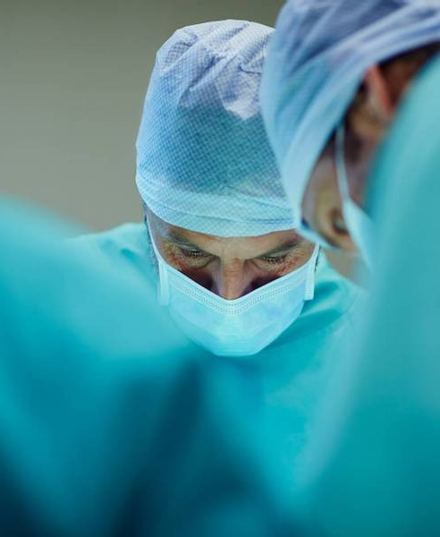
problem statement
m
All of this increases the need of doctors to cover the growth of healthcare needs.
so, governments and health care providers around the world are investing in new methods that facilitate more effective use of resources to meet demands.
in the hope to better harness the power of digital medical data and information technology to deliver enhanced services.

Slide 4

proposed solution
m
Artificial intelligence plays a crucial role in the advancement of information technology to improve healthcare service quality and efficiency. In particular, chatbots amount to one of the most popular AI technologies for this purpose. A chatbot is a software system that consists of an interactive interface with patients or medical practitioners to provide a range of knowledge extraction tasks and real-time, personalized feedback. Chatbot technologies have been rapidly developed, especially in the medical field. Many medical chatbot systems have been proposed over the years. Typical applications of chatbot include medical assistants that help patients to identify their symptoms, medical service front desks that direct the patient to suitable healthcare service departments, i.e., doctors, and so on.

Slide 5

proposed solution framework

Slide 6
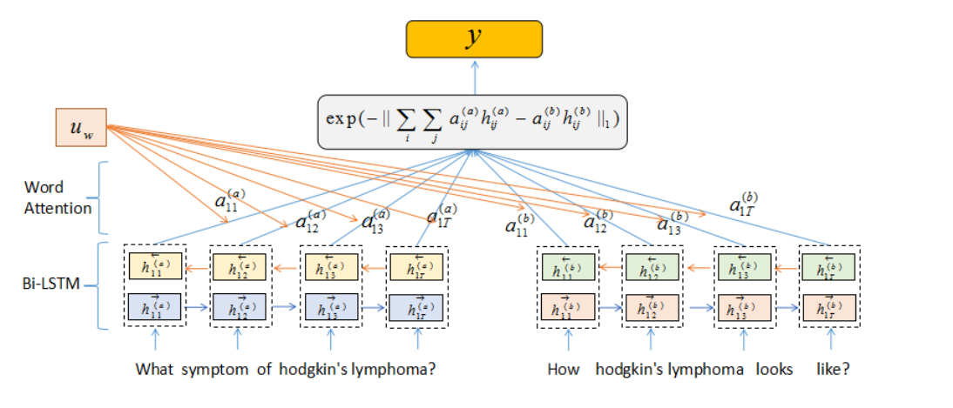
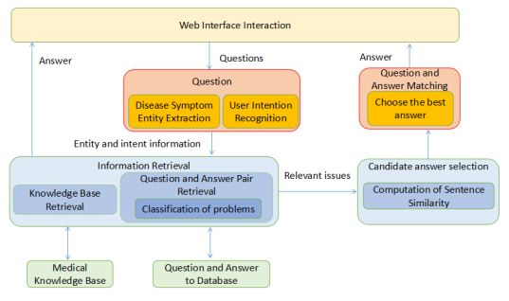
Model Structure
Z
The diagram of the new hierarchical BiLSTM Attention model we proposed is shown below in Figure 5.
It is designed for semantic similarity comparison. The whole structure based on a Siamese LSTM framework . We apply one BiLSTM layer and one word attention layer into the Siamese framework. The bottom left, and the right sentences represent user input query and the question from the QA dataset.
The two questions will be represented by using word embedding firstly and then using BiLSTM to form the whole sentence embedding based on the context. After that, each BiLSTM encoder will be multiplied by a word attention value, which can be assumed as a weight to highlight the key-point in a sentence. Context vector will be combined with attention to understanding the sentence representation uw

Slide 7

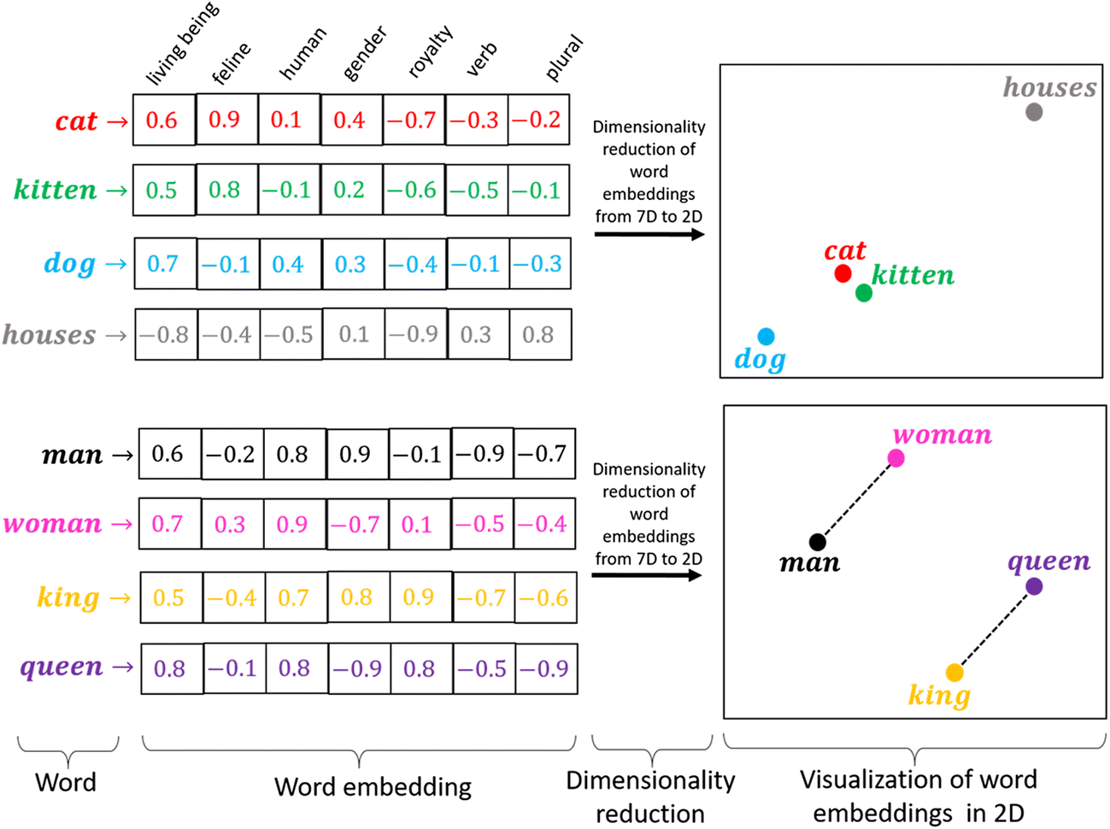
embedding equation
z
each word of the sentence will be embedded by using an embedding matrix W
King - man + woman = queen

Slide 8
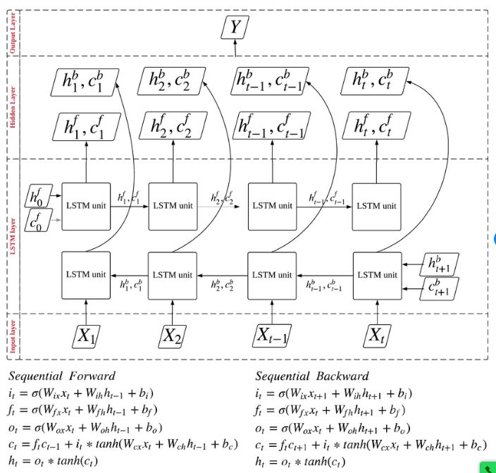
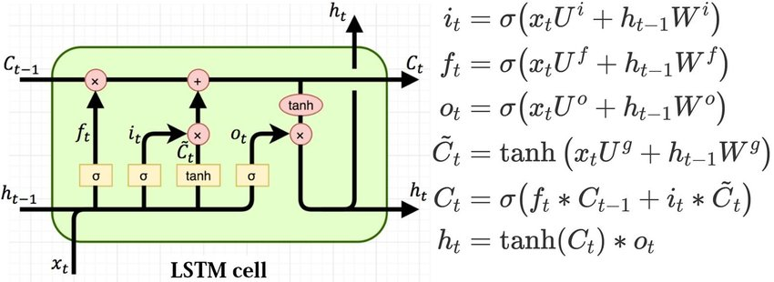

bilstm Structure equation
Z
We use Bidirectional LSTM to capture both forward and reverse direction information of each word. The bidirectional LSTM contains forward LSTM forward and reverse LSTM backward.
-> project manager Ahmed said " We have to be brave "
-> Ahmed said " We have to be brave " - project manager -

Slide 9
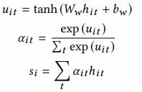

Attention equation
Z
We try to use Attention. Firstly, we feed the hit into the tanh function to get uit as a hidden representation of hit . Secondly, we calculate the importance of each word uit and get a normalized importance weight αit by using a SoftMax function. Then, we calculate the sentence vector sı as a weight sum of each word with its weight
Similarity function
The formula is based on Manhattan distance. From this formula, the representation from two sentences can represented

Slide 10

Code Implementation steps

Slide 11
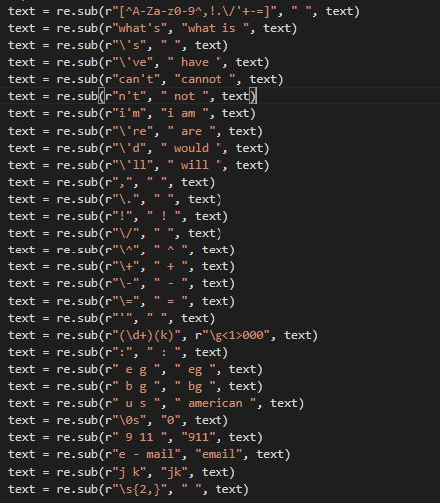

Step 1 :
A
pre-processing Data :
Preprocessing by cleaning Dataset from uni-char or replace with more meaning characters for example like replace it's with it is
also by excluding stop words

Slide 12
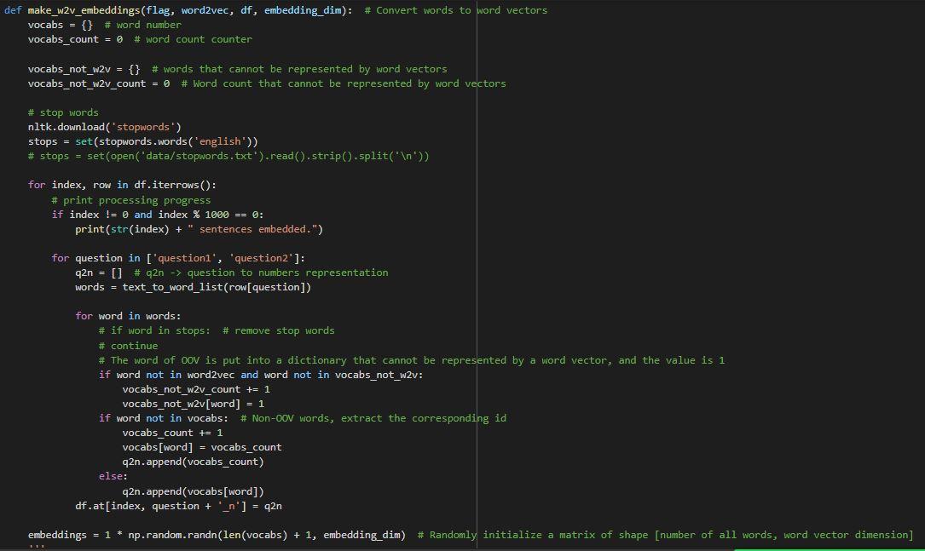

A
Step 2 :
Word to vector
words send to embedding layer to convert words to vector before send it to our model

Slide 13
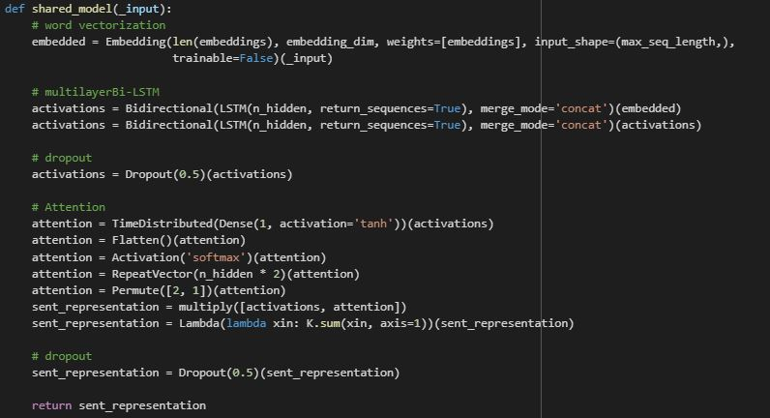
A
Step 3 :
Model
Our Model that include two layer of BI-LSTM and one attention layer and drop-out to prevent over fitting

Slide 14
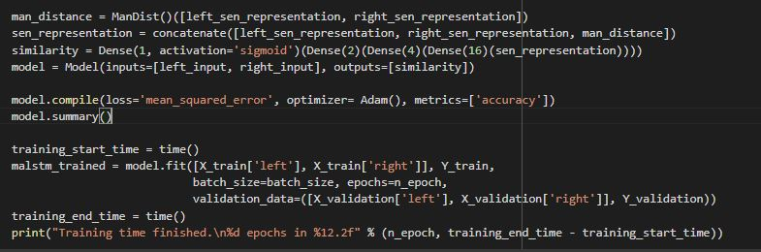
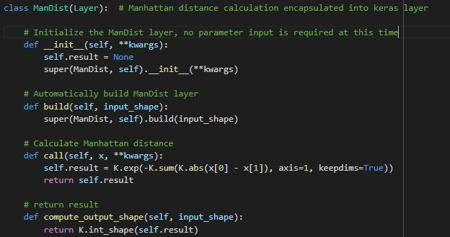
A
Step 4 :
Training Function
This is our training block that includes our hyper parameters to apply our model with manhattan distance layer for similarity

Slide 15
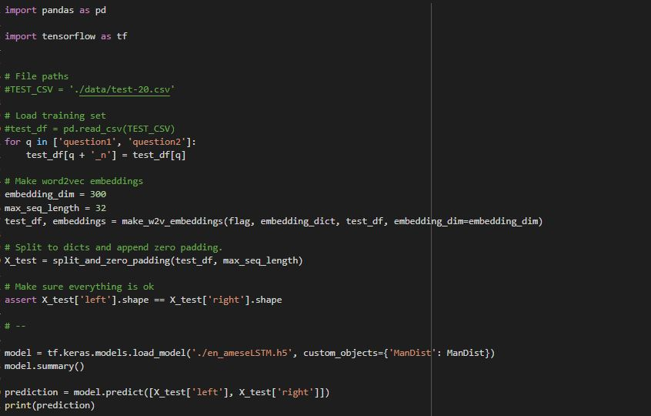
A
Step 5 :
Model test
This block is to extract predication depending on our saved trained model

Slide 16

Novility

Slide 17
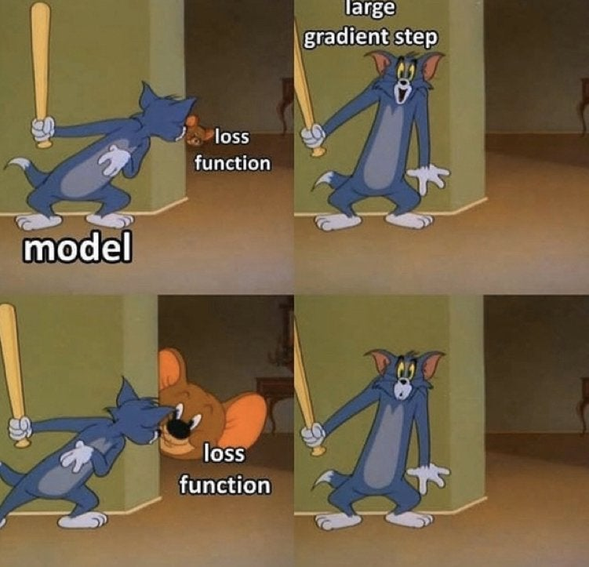
Novility
A
Novility :
as our Team tried to add novelty to this research by trying to enhance the existing model or try another model to get better results and in the following points, we will demonstrate in brief our final efforts that leads to enhance model results and accuracy
Preprocessing Data (remove stop words).
Model hyper parameters & drop-out amendment.
Modify max_seq

Slide 18

Experiments

Slide 19
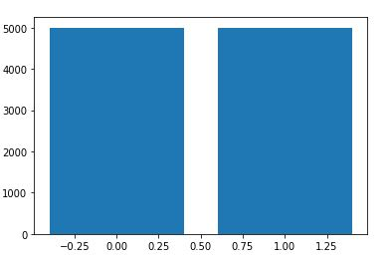
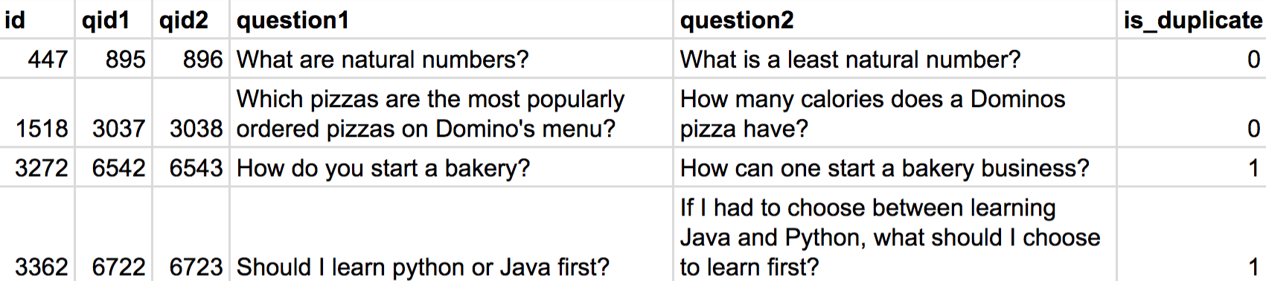
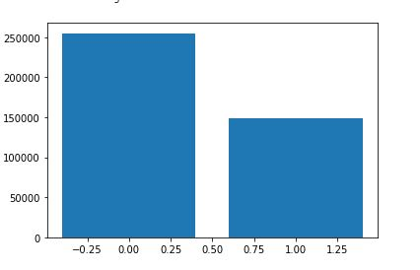
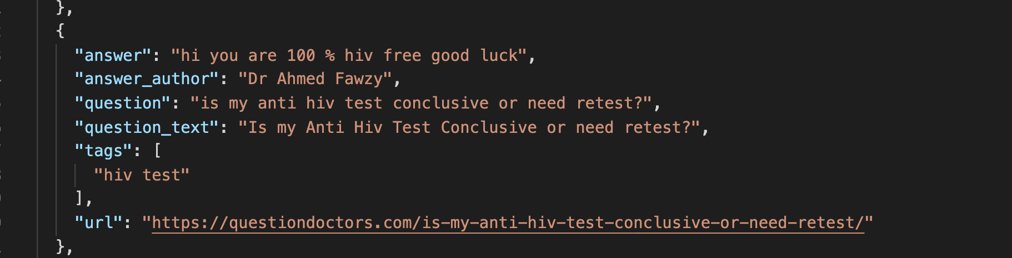
Dataset
A
Quora Question Pairs :
firstly, we tried to use full Quora medical dataset as a part of our novility but not give us good results.
so, we worked on selective research medical dataset and was balanced that contains question1 & question 2 for our model.
Dataset | URL
Quora Question Pairs ​ ​(github ) | https://github.com/14H034160212/HHH-An-Online-Question-Answering-System-for-Medical-Questions/blob/master/Data/Model_train_dev_test_dataset/Other_model_train_dev_test_dataset/train.csv
Quora Question Pairs ​ (kaggle ) ​ | https://www.kaggle.com/c/quora-question-pairs/data
Medical Question/Answer dataset ​ | https://github.com/LasseRegin/medical-question-answer-data

Slide 20
Experiments
m
Experiments:
(partial experiments report/total experiment count: approx. 100/Best experiment result with snapshot)
Full Dataset = 240000

Slide 21
Experiments
m
Baseline result
Filtered balanced Dataset =10000
Best result in our experiment

Slide 22
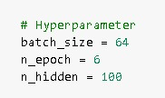

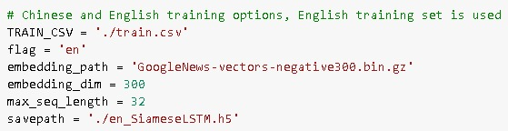
m
best experiment result
This is our best experiment result we got in the below snapshot
hyper parameter
Comparing to the research paper their Final result :
max_seq_length = 10
batch_size = 1024
n_epoch = 9
n_hidden = 50
Dropout = 0.1
Average eval_accuracy by 30 times experiments: 0.8043
Dropout
max_seq

Slide 23
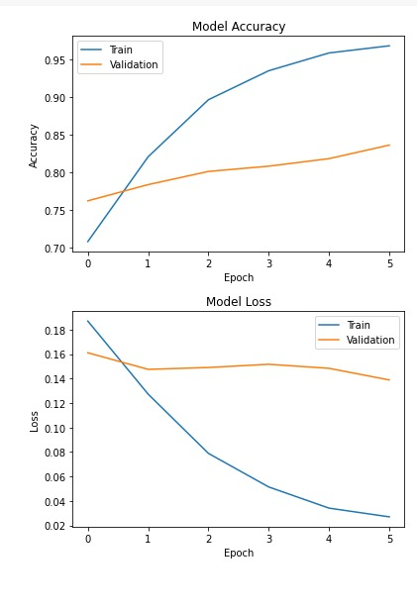
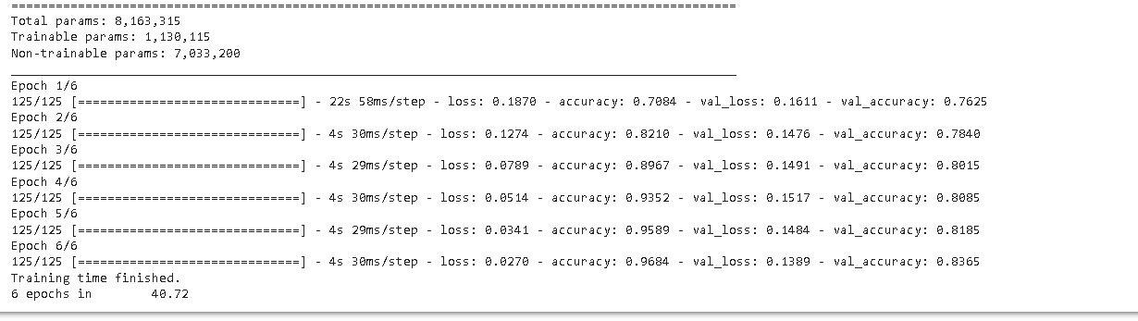
M
best experiment result
This is our best experiment result we got in the below snapshot

Slide 24
Qualitative Results
z
InputQ | RealatedQ | RealatedQ_prediaction | RealatedQ_tags | RealatedQ_answer | RealatedQ_index
iâ€™m swollen through the stomach neck and face. i have no energy like i used to? | neck inflammation and head tensionâ€¦affecting my life | 0.98146 | ['neck inflammation'] | i suggest you do neck exercises to strenghthen the neck muscles apply local gel hot fomentation apply cervical collar thanks | 5542
i have had a loud high-pitched ringing in both of my ears for the past year now? | ear pain in my right ear | 0.89577 | ['ear pain'] | hi. if the doctor says its not infection then it may be neuritis a inflammation of the nerves inside the ear. consult a ent specialist and get a otoscopy done to see whats wrong. thanks | 5451
2 year old girl cannot walk doctors baffled? | two years ago i was diagnosed with colon cancer? | 0.89131 | ['diagnosed with colon cancer'] | it is common after surgeries as digestion is not as it used to be before so you should try eating small portions and avoid excess diary products and increase fiber intake. | 850
i had a spider crawl in my ear got out but i was left with an ear infection? | ear pain in my right ear | 0.2723 | ['ear pain'] | hi. if the doctor says its not infection then it may be neuritis a inflammation of the nerves inside the ear. consult a ent specialist and get a otoscopy done to see whats wrong. thanks | 5451
iâ€™m a 32 year old male. i had a uti just over a year? | my mom has kidney failure diabetes sarcoidosis heart failure she now has these big knots why? | 0.06531 | ['sarcoidosis'] | hi this is probably swollen lymph nodes from sacroidosis also if she is on corticosteroids then she can have pumps like this all over if i am here doctor i would not focus on this instead i would focus on the bigger issues good luck | 55

Slide 25
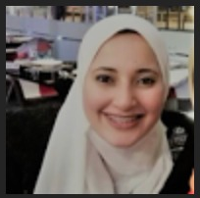
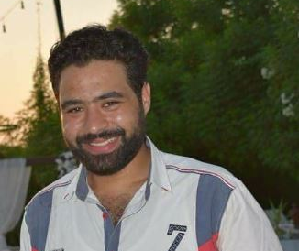

Meet the team
Zeinab Abdelmawla
Ayman Abdeen
Michael waheeb

Slide 26

Thank you

